Slide 1

Know Where You Stand
LetMeIn
A ShinyApp by Chunxiao Li,
Yunlu Hao, Wenwen Ye, Xuetong Li,
Elizabeth Kim
a.k.a. YHXLCLWYEL

Slide 2
So you
decided to
apply to grad
school…

Slide 3
…in
statistics.

Slide 4
But where
should
you apply?

Slide 5
Some Factors:
GRE Scores
GPA
International?

Slide 6
Here’s what
usually
happens…

Slide 7
End result:

Slide 8
LetMeIn
makes this
easier.

Slide 9
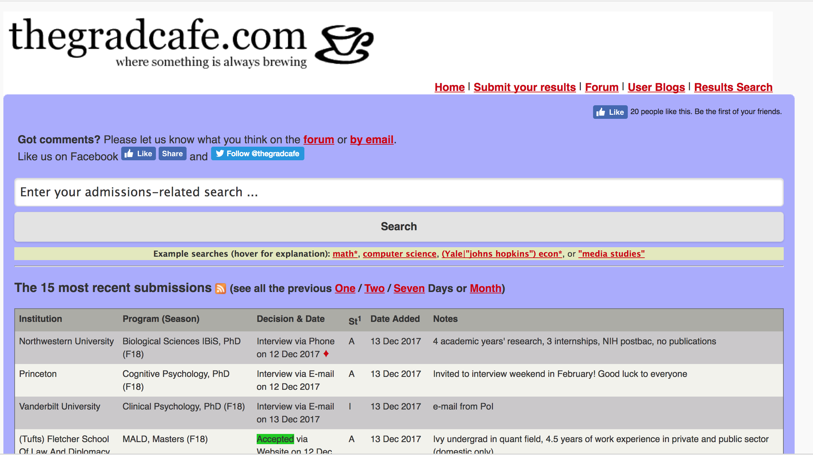
What is PROJECT TITLE?

